Slide 1
Collaboration and Integration of College Marketing & Outreach “A Tale of Two Colleges”
Presented by
Laura Gropen, M.S.A.
Director, Communications, Marketing and Public Affairs
and
Dr. Kendyl Magnuson
Acting Co-Vice President, Student Services and
Director, Enrollment Services
Palomar College

Slide 2
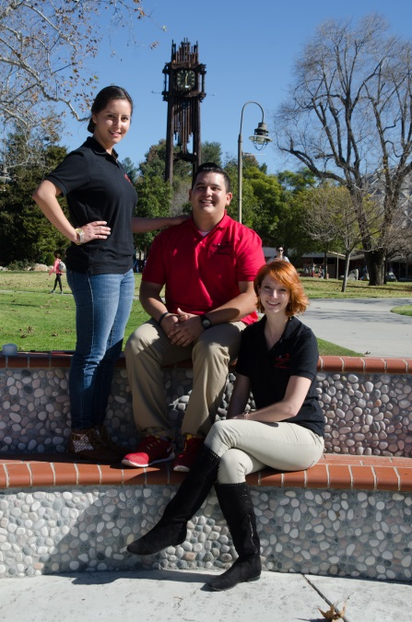
Palomar College College of San Mateo
A tale of two college outreach stories
One North and One South

Slide 3
The Overview
The Community College Paradigm
The Challenges
Centralized vs Decentralized
The Opportunity
The Vision
Implementing the Plan
Notes:
Bringing in new perspectives – prevailing paradigm is you get the word out, they will come
CSUSM – LG to describe that seven years ago they were 8,000 now 15,000 and plan to be 30,000

Slide 4
The Starting Point
Multiple Outreach Activities Throughout the College
Institutional Marketing

Slide 5
The Challenges
Large and geographically expansive district
Reduction in community communications outlets
Increase in competition
Inconsistent branding
Funding
restrictions
Notes:
Increased in competition -- not only increased competition – the people we are competing against are more sophisticated and with more resources
Funding – increased funding through growth – which means you have to recruit; what’s made it even worse, because of the competition and lack of growth in our potential student populations, we may need to recruit just to maintain.
Influx of 3SP and Student Equity money – concern about long-term stability and the challenge of ramping up so quickly

Slide 6
Activities
Market Research
Audit Activities – 3SP
Identified and Planned Staffing Needs
Collaboration and Integration
Notes:
Conducted both internal and external market research – to determine student and community perception and communications preferences
Audit – LG to identify numbers of activities (e.g. # of departments were involved in some type of outreach activities and were acting independently)
Collaboration and Integration – 1) Creative Service and Reprographics was enfolded into Marketing/Public Affairs Office; 2)

Slide 7
The New Model
Marketing
Outreach
In reach

Slide 8
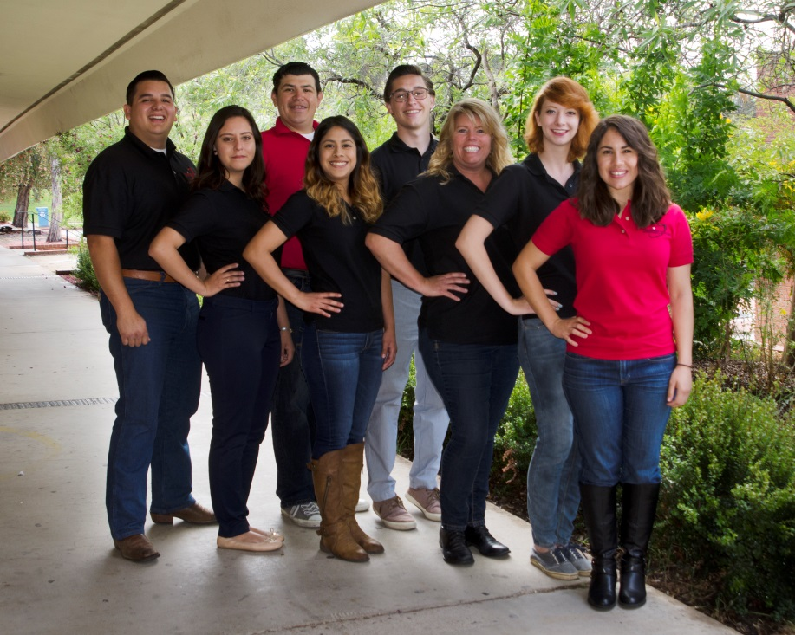
Implementing the Plan
Community Outreach
Cohesive Branding
Student Ambassadors
Notes:
Student Ambassadors – summer drop for non-payment story – Kendyl and the radio interviews -- Laura

Slide 9
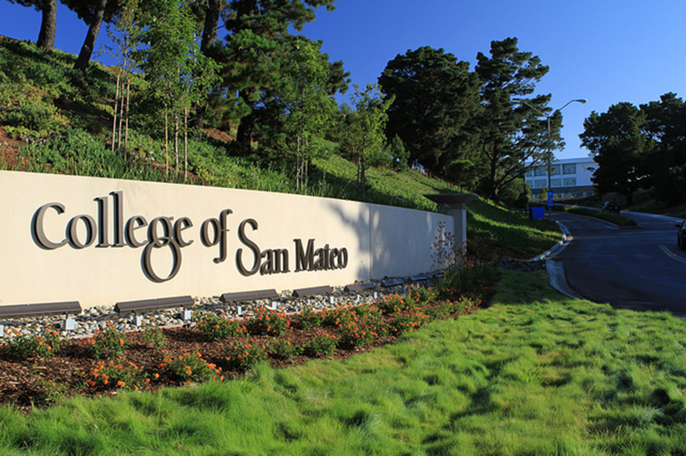
Success Story
College of San Mateo
Complete Integration
Outreach Resides in Marketing
Supported from the President’s Office

Slide 10
Timeline | Major Accomplishments – College of San Mateo
2007-08 | Convert PT Outreach Program Services Coordinator to FT 1 student ambassador
2008-09 | Launch new college website; new college brand; create 1st college view brochure; College President speaks to high school parent groups 4 student ambassadors
2009-10 | Student ambassadors assigned to feeder high schools, support on campus events and take over campus tours 6 student ambassadors
2010-11 | Implement online tour form, standardized tour offerings; create outreach advisory council 8 student ambassadors
2011-12 | CR&M moves into new College Center; students staff 2nd floor counter 8 student ambassadors; 1 student ambassador lead
2012-14 | 10 student ambassadors; 1 student ambassador lead
2014-15 | College tours up 30% over previous year; over 1,000 tours conducted 10 student ambassadors; 2 student ambassador leads
Notes:
** Bev provides overview; Mike shares high school take rates NOW

Slide 11
Timeline | Major Accomplishments – Palomar College
2012-13 | On-going centralized community outreach Creative Services moved to Marketing
2013-14 | Audit of college-wide outreach activities. 49 distinct department/program level outreach activities were cataloged. Created new 3SP/Student Equity Council as part of our formal governance structure in order to integrate these programs into existing discussion and planning.
2014-15 | Website redesigned Hired 1 FT Manager, Orientation and Follow-up Services, 8 student ambassadors, and 1 lead student ambassador. Ambassadors took over all campus tours, participated in high school visits, and screening students in line for admissions and financial aid. 3SP/Student Equity Council begins comprehensive discussions to integrate categorical resources towards program plan goals.
2015-16 | Hired Director, Student Success and Equity, expand ambassadors to 12, and post new Manager, Outreach position.

Slide 12
Questions

