Slide 1
Institutional Effectiveness Partnership Initiative and Enrollment Management
Presented by:
Theresa Tena, Vice Chancellor, California Community College Chancellor’s Office
Paul Steenhausen, Executive Director, Success Center for CCC
August 2015

Slide 2
Institutional Effectiveness
Partnership Initiative
  Designed to bolster community colleges’ ability to deliver outstanding educational programs and results to students by drawing on expertise within the system
Funded by the Legislature
Administered by the Chancellor’s Office

Slide 3
Institutional Effectiveness
Partnership Initiative (cont.)
  Desired Outcomes Are to:
  Help make the California Community Colleges the most effective system of higher education in the world
  Eliminate accreditation sanctions and audit findings at colleges
  Enhance access, success, and equity for our students

Slide 4

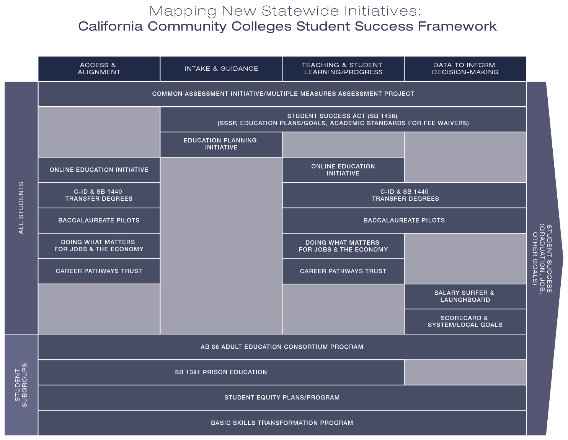

Slide 5
Institutional Effectiveness
Partnership Initiative (cont.)
Executive Committee
  Chancellor’s Office
  College of the Canyons
  Foothill College
  State Academic Senate
  Success Center (funded by Kresge Foundation)
Advisory Committee
  Made up of 17 statewide organizations
  Workgroups provide input to Executive Committee on the initiative’s three major components

Slide 6
Institutional Effectiveness
Partnership Initiative (cont.)
Major Components
  Framework of Indicators and College Goals
  Technical Assistance (“Partnership Resource Teams”)
    Expect consultations and implementation grants available to colleges seeking to improve

Slide 7
Institutional Effectiveness
Partnership Initiative (cont.)
Major Components
  Professional Development
    Construction of online clearinghouse of effective practices, trainings, and other resources
    Organize regional workshops and other face-to-face events

Slide 8
What Indicators Are in the Framework?
Student Outcomes
Completion
  Prepared
  Unprepared
  Overall
Remedial Rate
  Math
  English
  ESL
CTE Completion Rate
*Course Completion Rate*
Degrees
Certificates
Transfers
Accreditation Status
*Accreditation Status*
Fiscal Viability
Salary and Benefits
FTES
Annual Operating Excess/Deficiency
*Fund Balance*
Cash Balance
State and Federal Programmatic Compliance
*Overall Audit Opinion*

Slide 9
Indicator Framework and Enrollment Management
A Strong Enrollment Management System Can Help Colleges Achieve Their Goals Across the Indicator Framework
  Meet Students’ Educational Needs and Boost Student Outcomes
  Meet Accreditation Standards Expectations
  Generate FTES and Operating Revenue to Stay Fiscally Sound

Slide 10
How Are the Partnership Resource Team (Technical Assistance Team) Visits Structured?
Not Just a Single Visit: Each Team Commits to 3 Visits or More As Needed
The Visits are Designed to:
  Understand Issues and Identify Scope of Support
  Develop Ideas for College’s Innovation and Effectiveness Plan in Various Areas
  Provide Follow Up Support As Needed

Slide 11
Partnership Resource Teams
Grants of Up to $150,000 as Seed Money to Expedite Implementation of College’s Innovation and Effectiveness Plan (Available Until Funds Run Out)
College CEO Completes Short Letter of Interest
Team Visits Started in May and June 2015.
  All Eight Colleges Visited Cited Enrollment Management as an Area of Focus

Slide 12
Sample of Needs Identified by Colleges
More Coordination/Integration Across Program Areas
Less Reliance on Historical Course Scheduling; More Reliance on Data-Based Decision-making
Better Data Integrity and Timeliness
More Effective Outreach and Marketing

Slide 13
Sample of Issues Identified by Colleges (cont.)
Knowing “When to Hold Them, When to Fold Them”
Restoration/Preservation of Institutional Memory Around Enrollment Management
Need to Clarify College’s Strategic Plan to Inform/Drive Enrollment Management Approach

Slide 14
Next Steps for IEPI
2015-16 Budget provided a significant augmentation ($2.5 M to $17.5 M) for IEPI. Chancellor’s Office received total of 6 new staff
Board of Governors to act on 2015-16 IEPI goals framework at November 2015 meeting
Roll out of IEPI Strategic Communications— Ensure colleges/districts and external audiences understand value and benefits

Slide 15
Next Steps for IEPI (cont.)
Received $3 M for portion of grant administered via partner College of the Canyons
Will Allow Partnership Resource Teams to increase from 8 in Spring 2015 to roughly 20 new college visits in Fall 2015
Intent to establish a VOLUNTARY Community of Practice focused on colleges/districts visited by Teams. Goal to have first multi-day cohort in Spring 2016

Slide 16
Next Steps for IEPI
  $12 M to identify and disseminate effective practices—Board of Governors to award RFA at November 2015 meeting
    Develop content/materials
    Dedicated staff to develop content and coordinate the activity
    Resources to disseminate content—in person, online, regional
    Support the Online Clearinghouse
    Evaluation of the activity

Slide 17
Contact Information
Theresa Tena VC IE, Chancellor’s Office, ttena@cccco.edu
http://extranet.cccco.edu/Divisions/InstitutionalEffectiveness.aspx
Dr. Paul Steenhausen, Exec Director, Success Center psteenhausen@cccco.edu
Dr. Barry Gribbons, Deputy Chancellor, College of the Canyons, barry.gribbons@canyons.edu
Dr. Matthew Lee, IEPI Project Director, matthew@mcleeconsulting.com
www.canyons.edu/IEPI
Please Be Sure to Complete the Workshop Survey!
https://www.surveymonkey.com/s/EnrollManage2

