Slide 1
Enrollment Management
Case Studies
Dr. Gregory Peterson
Vice President of Student Support Services
Long Beach City College
Dr. Omid Pourzanjani
Vice President of Instruction and Student Learning
Golden West College

Slide 2
Recruitment to Completion
(1)
Programming
(4)
Assessment
(7)
Scheduling
(Enrollment)
(2)
Outreach /
On-boarding
(5)
Educational Planning
Graduation/ Completion
(3)
Orientation
(6)
Retention &
Completion

Slide 3
Overview
Look at how different components come together to create an enrollment management plan
Examples are provided to help you brainstorm your own possibilities
Most ideas are pilots – Scaling is recent, in progress, or planned
A focus on access through completion and success is new/renewed

Slide 4
Recruitment to Completion
(1)
Programming
(4)
Assessment
(7)
Scheduling
(Enrollment)
(2)
Outreach /
On-boarding
(5)
Educational Planning
Graduation/ Completion
(3)
Orientation
(6)
Retention &
Completion

Slide 5
Area 1: Programming
How do you define and articulate to potential students the educational opportunities provided by your college?
Session Example Strategies:
Completing a comprehensive review of offerings and marketing plan
Developing k-16 career pathways
Targeted accelerated university transfer programs

Slide 6
Review of Offerings
Programming
College Readiness Bootcamps
STEM Readiness Bootcamps
Out of work college grads
Fresh Out of High School
Career Change
Upskilling/ Skills Update
2 Year Full-Time Roadmaps
3-4 Year Part-time Roadmaps
2-3 Years Full-Time
STEM Defined Pathways
Biology Kinesiology Chemistry Geology Nursing Mathematics Computer Science
More coming soon!
Work Readiness Bootcamps
4/6/8 week sessions Night
Weekend
Hybrid
CTE
Roadmaps
AA/AS Degree and Transfer
Direct to Employment

Slide 7
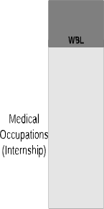
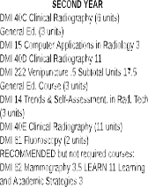
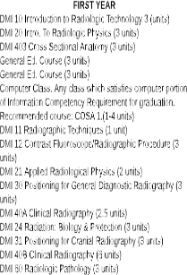
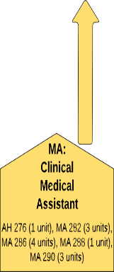
K-16 Career Pathways
Programming

Slide 8
Accelerated University Transfer Programs
Programming
ADTs are gaining popularity
Random course taking patterns versus major pathways and “cohorts”
CSUin2 is an example of this model

Slide 9
Two-Year Daytime Pathway
Programming
CSUin2
Notes:
I don’t mean to detract from the Accelerate One-Year Model. I definitely support that for a possible capacity of 250-1000 students.
In addition to that, I think the model below may have the potential to serve a population of 2500-5000. The GE patterns meets CSU-GE and IGETC Patterns and the load and hours are quite reasonable. Also, the FTES to LHE ratio is quite good at a factor of about 1.5!
I look forward to hearing your thoughts.

Slide 10
Two-Year – Evening Pathway
Programming
CSUin2
Prep course?
Notes:
Here is an evening two-year model. I think it is quite doable…

Slide 11
Area 1: Programming
How do you define and articulate to potential students the educational opportunities provided by your college?
Things to discuss and consider:
Need an inventory of programs you have and the gaps
Consider logical sequences of course-taking patterns
Consider interest and demand
How would you message and promote your offering?

Slide 12
Recruitment to Completion
(1)
Programming
(4)
Assessment
(7)
Scheduling
(Enrollment)
(2)
Outreach /
On-boarding
(5)
Educational Planning
Graduation/ Completion
(3)
Orientation
(6)
Retention &
Completion
12

Slide 13
Area 2: Outreach & Onboarding
How do you attract potential students and get them connected to your college?
Session Example Strategies:
Strengthening K-16 partnership or implementing “promise” agreements
Targeted on-campus freshman outreach activities
Leveraging industry ties to CTE programs

Slide 14
K-16 Partnerships & Promise Agreements
Outreach &
Onboarding
College Promise Agreements:
1. Early outreach/universal commitment 4th/5th Grade Tours, 6th Grade Commitment
2. Pipeline from CC to University LBUSD-LBCC-CSULB (+LBC)
3. Student Incentives LB College Promise Scholarship
Priority Admissions
Priority Registration
Multiple Measures Assessment

Slide 15
On-Campus Freshman Outreach
Outreach &
Onboarding
Turning visitors into applicants (25% increase)
College Application workshops and Financial Aid workshops during College Preview Day and Chican@/Latin@ Day
Increasing services during Freshmen Priority Day
Registering students in guided workshops
Adding Financial Aid workshops

Slide 16
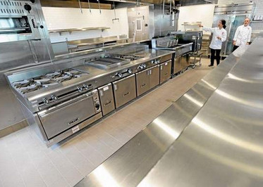
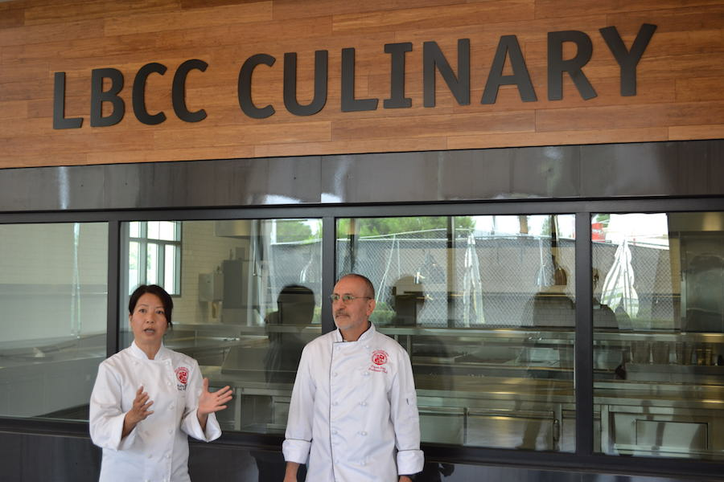
CTE Industry Ties
Outreach &
Onboarding
Long Beach Culinary Arts Program
Capitalizing on media attention of new facilities
Leverage advisory boards to market program and build capacity
Provide community/student “engagement points”

Slide 17
Area 2: Outreach & Onboarding
How do you attract potential students and get them connected to your college?
Things to discuss and consider:
What relationships can you leverage?
What are the programs you will be known for?
How do you get potential students on campus?

Slide 18
Recruitment to Completion
(1)
Programming
(4)
Assessment
(7)
Scheduling
(Enrollment)
(2)
Outreach /
On-boarding
(5)
Educational Planning
Graduation/ Completion
(3)
Orientation
(6)
Retention &
Completion

Slide 19
Area 3: Orientation
How do you ensure that new students have the information they need to navigate the college’s systems and ultimately enroll in and successfully complete classes?
Session Example Strategies:
Implementing just-in-time orientation models
Program-specific orientations

Slide 20
Just-in-Time Orientation
Pre Assessment
Math and/or English Prep Workshops
Post Assessment
Orientation[B]
Financial Aid (4)
Assessment (3)
Orientation[C]
Goal Exploration (5)
Ed Planning (8)
Transcript Submission
Results
Orientation [A]
Welcome (2)
(About GWC)
OpenCCC
Career Planning
Major Selection
Transcript
Evaluations
Preliminary
Ed Goal and Plan
GWC Application
Couns. Appt
Degree Planning (DW)
FAFSA Workshop
Formal
Ed Goal and Plan
Legend
Workshops/Activity
Orientation
Document/Output
Financial Activity
FAFSA Application
Counseling
Financial Support $
Orientation [D]
Registration (7)
Fees
Registration
One Week Prior to Start
Orientation [F]
Rights &Responsibilities (9)
Title IX(9)
Student Success Tips(9)
Orientation [E]
Academic Expectation (1)
Academic Support (5)
Student Support (5)
Student Schedule
First Day of Instruction
Pay
Fees
Onboarding Dashboard

Slide 21
Program-Specific Orientations
Orientation
The purpose of the orientation is to:
Provide a program overview, including safety requirements
Provide math skill assessment and opportunity to test out of Electrical Mathematics course and advance directly to next level
Outline certificate and degree requirements and assist with course selection
Nearly 30% (278 of 969) of students passed math assessment, testing out of ELEC 202 (Electrical Mathematics)
Course success rates increased on average 20 percentage points

Slide 22
Area 3: Orientation
How do you ensure that new students have the information they need to navigate the college’s systems and ultimately enroll in and successfully complete classes?
Things to discuss and consider:
Where are the best points in time to provide information?
What are the best formats/mediums to provide information?

Slide 23
Recruitment to Completion
(1)
Programming
(4)
Assessment
(7)
Scheduling
(Enrollment)
(2)
Outreach /
On-boarding
(5)
Educational Planning
Graduation/
Completion
(3)
Orientation
(6)
Retention &
Completion

Slide 24
Area 4: Assessment
How do you ensure that students are appropriately placed into college-level coursework so that they have the best chance to successfully complete certificate, degree, and transfer requirements?
Session Example Strategies:
Employing pre-assessment workshops
Piloting multiple measures assessment models
Using co-requisite models

Slide 25
Math Attrition in Basic Skills
Assessment

Slide 26
Employing Pre-Assessment Workshops
Assessment
Math Prep Workshop Results from Local High School
Pre or Post Workshop | Total Tested | Math 005 | Math 008 | Math 010 | Math 030 |  | Math 100 - 160 | Math 170 | Math 180 | Take Elem. Algebra Test | Take Interm. Algebra Test
Pre | 79 | 54 |  | 18 | 6 |  | 1 | 0 | 0 | 0 | 0
Post | 59 | 0 |  | 0 | 25 |  | 10 | 5 | 4 | 8 | 7

Slide 27
Unpredictable Outcomes?!
Course ID | Success Rates from 2010-11 and 2011-12 |  | Success Rates from 2012-13 to 2013-14
 | Enrolled | Success | Enrolled | Success
MATH 005 | 146 | 51.4%
MATH 008 | 546 | 41.9%
MATH 010 | 2,321 | 36.2% | 2,033 | 36.1%
MATH 030 | 2,898 | 46.6% | 3,048 | 50.6%
Overall | 5,911 | 42.2% | 5,081 | 44.8%

Slide 28
Piloting Multiple Measures
Assessment
% of students placed in transfer-level math and English courses by placement type and academic year

Slide 29
Piloting Multiple Measures
Assessment

Slide 30
Using C0-Requisite Models
Assessment
Integrate needed support in college-­level gateway courses. Depending on the needs of students, three methods are most effective:
1. Single-­semester, co-requisite approaches deliver remediation to students enrolled in traditional single­-semester, college­-level gateway courses.
2. One­-course pathways stretch common single­-semester gateway courses over two semesters instead, benefitting students in need of more academic help while ensuring them full credit that counts toward degrees.
3. Parallel remediation is effective for students enrolled in career technical or applied degree programs. Any academic shortcomings are addressed in connection to the program of study, so needed English and math remediation do not become obstacles to beginning coursework.

Slide 31
Area 4: Assessment
How do you ensure that students are appropriately placed into college-level coursework so that they have the best chance to successfully complete certificate, degree, and transfer requirements?
Things to discuss and consider:
How can you make assessment less of a barrier?
How can you accelerate student progress while ensuring readiness?

Slide 32
Recruitment to Completion
(1)
Programming
(4)
Assessment
(7)
Scheduling
(Enrollment)
(2)
Outreach /
On-boarding
(5)
Educational Planning
Graduation/ Completion
(3)
Orientation
(6)
Retention &
Completion

Slide 33
Area 5: Educational Planning
How do you guide students to identify a meaningful academic goal and give them clear directions and support in order to achieve that goal in a timely manner?
Session Example Strategies:
Leveraging abbreviated and comprehensive Student Education Plans (SEPs)
Scaling counseling models
Linking SEPs to schedule creation

Slide 34
Leveraging SEPs
Ed Planning
Existing vs. New Students
 | Student Headcount
 | Existing | New | Total
CTE Cert Only | 2400 | 400
EOPS | 750 | 250
DSPS | 700 | 200
International | 200 | 100
Athletes | 200 | 100
ESL | 500 | 100
Major Known | 2000 | 200
1-2 courses | 2500 | 400
Freshman Priority |  | 1000
Other Major Unknown | 4000 | 1000
Financial Aid
Total | 13250 | 3750 | 17000

Slide 35
Scaling Counseling Models
Ed Planning
Part-time Counselors |  | Abbr SEP | Full SEP
Cost/hr | 55
Catego. Funds | $ 350,000
Hours | 6087
Workshops | 40% | 9180 | 1020
eSEP | 10% | 609
Express | 10% | 609
regular | 10% |  | 609
Other | 30%
 |  | 10397 | 1629
Full Time Counselors
Counselors | 10
Avg Salary | $ 120,000
hrs/counl/year | 1200
Total counl Hrs | 12000
Cost/hr | $ 100.00

Slide 36
Linking SEP to Schedule Creation
Ed Planning
How accurate is our SEP data?
How accessible is our SEP data?
How closely are students following their SEPs?
How do you incentivize a student to follow an SEP?
How many colleges are they maintaining SEPs at?
Tying priority registration to courses on SEPs
Could SEP data be used to inform scheduling?

Slide 37
Area 5: Educational Planning
How do you guide students to identify a meaningful academic goal and give them clear directions and support in order to achieve that goal in a timely manner?
Session Example Strategies:
How can you get more students on a guided pathway earlier?
How can SEPs inform your scheduling process?

Slide 38
Recruitment to Completion
(1)
Programming
(4)
Assessment
(7)
Scheduling
(Enrollment)
(2)
Outreach /
On-boarding
(5)
Educational Planning
Graduation/ Completion
(3)
Orientation
(6)
Retention &
Completion

Slide 39
Area 6: Retention & Completion
How do you keep students engaged and progressing towards their academic goals? How do you help them achieve their goals?
Session Example Strategies:
Employing tuition fee payment strategies and other financial supports for students
Using proactive “nods and nudges” to communicate to students vs. compliance communication
Detecting near finishers early & identifying overlooked completers
Getting students connected and engaged

Slide 40
Employing Financial Supports
Retention & Completion
Drop for Non-Payment
First batch dropped 17 out of 717.
Dropped less than 50% in total for the term.

Slide 41
Payment Strategies & Financial Supports
Retention & Completion
Dropping for Non-Payment
Emphasizing FAFSA Deadline/Timely Awarding
Availability of Textbooks—Textbook Vouchers
http://oerconsortium.org/
http://rrut.com/free-college-textbooks-online/
Streamlined Promise Scholarship
Student Payment Plans

Slide 42
Persistence Predictors
Data from Civitas implementation at GWC:
Students taking 6 or more units were significantly more likely to persist than those taking only one class.
Those with a 2.20 GPA or higher are significantly more likely to persist.
There is a persistence tipping point for students receiving $300 or more per unit for Financial Support.

Slide 43
Nods and Nudges
Retention & Completion

Slide 44
Focusing on Success: Nods and Nudges
Retention & Completion
[Sending probation/disqual letters each semester]
Sending out letters to first-semester and first-year completers congratulating them
Tracking and connecting with students that have finished 30 units with the college
Searching through records for students that are 2-3 courses from completion
Which is harder: Getting new students or keeping the ones the college has?

Slide 45
Early Detection of Near Finishers or Overlooked Completers
Retention & Completion

Slide 46
Early Detection of Near Finishers or Overlooked Completers
Retention & Completion
Notes:
the SPAR rate is significantly lower than the 30 unit completion rate. This means lots of students are making quite a bit of progress towards a completion but still end up with no official completion. These students are an easy target for additional completions.

Slide 47
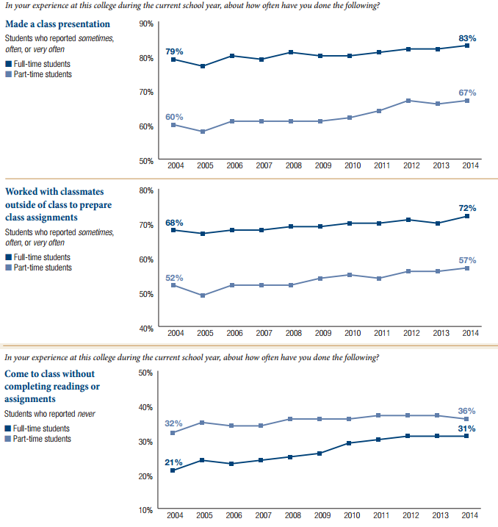
Student Engagement
http://www.ccsse.org/docs/Engagement_Rising.pdf

Slide 48
Student Engagement Strategies
Academic goal setting and planning
Orientation
Accelerated or fast-track developmental education
First-year experience
Student success course
Learning community
Experiential learning beyond the classroom
Tutoring
Supplemental instruction
Assessment and placement
Registration before classes begin
Class attendance
Alert and intervention
http://www.ccsse.org/docs/Matter_of_Degrees_2.pdf

Slide 49
Area 6: Retention & Completion
How do you keep students engaged and progressing towards their academic goals? How do you help them achieve their goals?
Things to discuss and consider:
Improving financial support strategies such as delaying-drops and textbook vouchers
Using positive reinforcements
Proactively monitoring students’ success
Impact of student engagement and connection to the college and other students

Slide 50
Recruitment to Completion
(1)
Programming
(4)
Assessment
(7)
Scheduling
(Enrollment)
(2)
Outreach /
On-boarding
(5)
Educational Planning
Graduation/
Completion
(3)
Orientation
(6)
Retention &
Completion

Slide 51
Area 7: Scheduling
How do you most efficiently schedule courses in order to increase student persistence and completion?
Session Example Strategies:
Employing regular schedule analysis
Monitoring waitlists and success rates
Establishing course priorities

Slide 52
Regular Schedule Analysis
Scheduling
Year Ahead vs. JIT
How much of your schedule should be published a year in advance?
Disconnecting scheduling from faculty assignments!
How much of the schedule should be Just-in-Time?
Consideration for random demands?
Consideration for student educational plans?

Slide 53
Demand vs. Contribution
Scheduling
Four Quadrants
Green (Q1): High demand, High capacity
Amber (top left) (Q2): High demand, low capacity
Red (Q3): Low demand, low capacity
Amber (bottom right) (Q4): Low demand, high capacity
Santanu Bandyopadhyay @ cypresscollege.edu

Slide 54
History 101 is a high demand course and wants to add more sections
Monitoring Waitlists
Scheduling
JoAnna Schilling @Cerritos.edu

Slide 55
Solid Fill Ratio, Completion, and Success
Scheduling
JoAnna Schilling @Cerritos.edu

Slide 56
Establishing Course Priorities
Scheduling
Psychology and Poli Sci 101 Are Also High Demand Courses
JoAnna Schilling @Cerritos.edu

Slide 57
To Add or Not To Add PSYCH 101?
Scheduling
JoAnna Schilling @Cerritos.edu

Slide 58
What Would You Do?
Scheduling
JoAnna Schilling @Cerritos.edu

Slide 59
Area 7: Scheduling
How do you most efficiently schedule courses in order to increase student persistence and completion?
Things to discuss and consider:
Tools and practices for schedule analysis
Tools and practices for monitoring enrollment trends
Establishing course priorities

Slide 60
Q&A
Discussion

Slide 61
Enrollment Management
Case Studies
Dr. Gregory Peterson
Vice President of Student Support Services
Long Beach City College
gpeterson@lbcc.edu
Dr. Omid Pourzanjani
Vice President of Instruction and Student Learning
Golden West College
opourzanjani@gwc.cccd.edu

