Slide 1
Self Matters:
Confronting Stress and Taking Care of Yourself
Sue Brandy, LCSW
November 9, 2012.

Slide 2
How heavy is this
glass of water?

Slide 3
What is stress?
Stress is the body’s reaction to a change that requires a physical, mental or emotional adjustment or response.
Stress can come from any situation or thought that makes you feel frustrated, angry, nervous or anxious.
Stress is any uncomfortable “emotional experience accompanied by predictable biochemical, physiological and behavioral changes”.

Slide 4
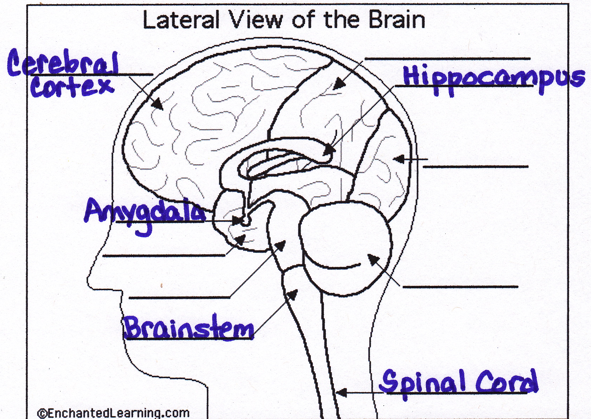

Slide 5

BRAINSTEM
(Reptilian brain)
MOST PRIMAL
Fight
Flight
Freeze
Evolutionarily programmed to react, expect the worse, think about all the
possible “what if’s”

Slide 6

LIMBIC SYSTEM
(old mammalian brain)
amygdalla
hippocampos
Evaluates current situation
emotions
relationships
**Stimulates release of cortisol to put entire metabolism on high alert to meet
stressful challenge

Slide 7

CORTEX
(new mammalian brain)
Allow us to think about thinking
Location for ideas
concepts
insight
empathy
sense of self
sense of senses
** Necessary for REGULATING brain stem & limbic system; MANAGING STRESS!

Slide 8
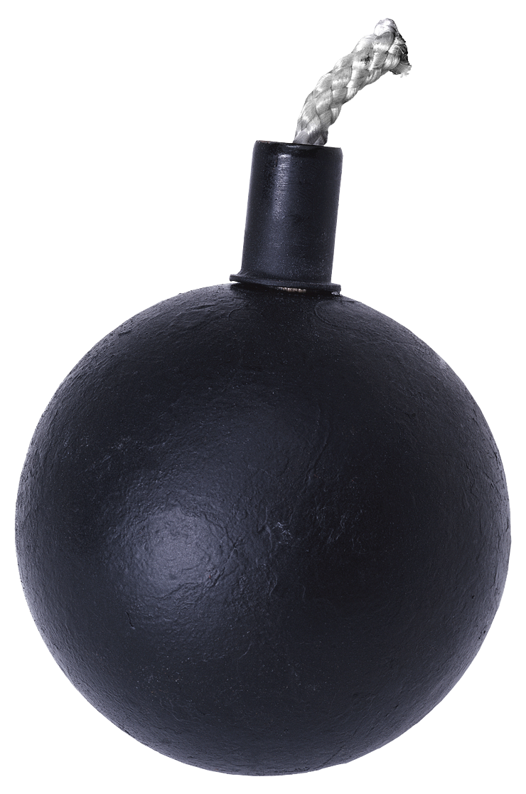
WHERE DO YOU EXPERIENCE
STRESS IN YOUR LIFE?

Slide 9
Types of Stress
Personal Stress - direct experience
  Work
  Family
  Finances
  Leisure
  Health
Secondary Stress
  What you see, hear, experience through someone else

Slide 10
Types of Stress
Cumulative Stress
  Repeated exposure to same stressor
  Multiple exposures to different stressors
Vicarious Stress
  Continuous exposure that changes perception of the world
Critical Incident Stress
  A strong emotional response to an unusual event

Slide 11
What is a Critical Incident?
A situation that is traumatic for the students/employees involved
Causes the student/employee to experience a stress reaction
May be different for each organization and each individual

Slide 12
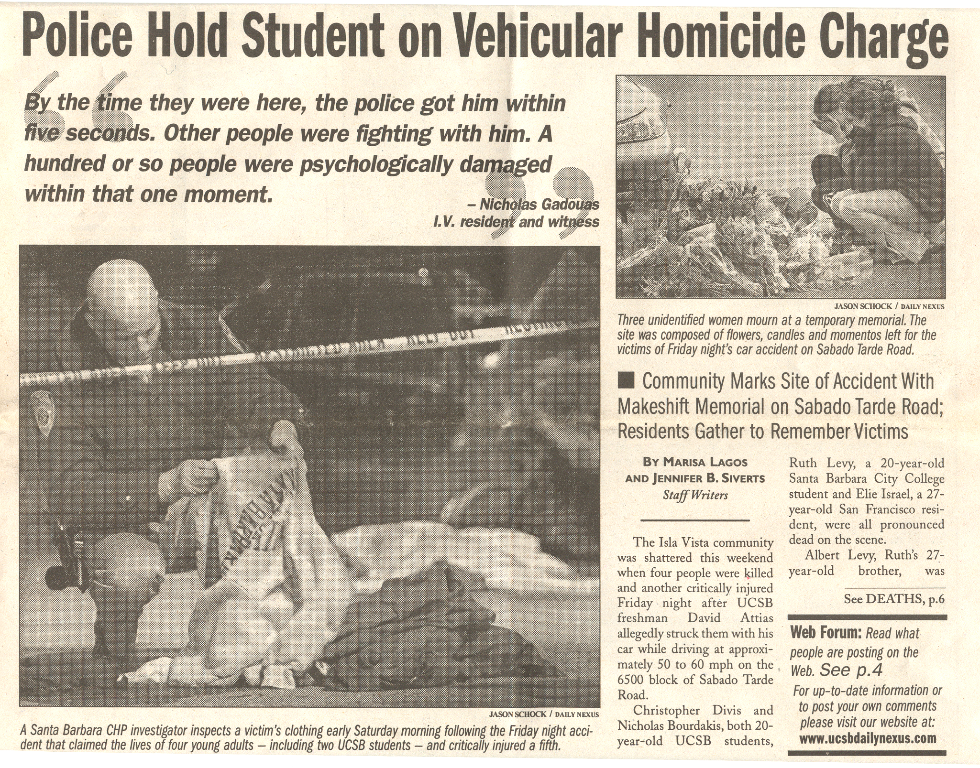

Slide 13
Critical Incident Stress Management, CISM
A number of interventions for dealing with traumatic events
  Formal
  Structured
  Professionally recognized
Helps those involved in a critical incident to share their experiences, vent emotions, learn about stress reactions and symptoms
Confidential, voluntary, educative process
NOT therapy

Slide 14
Debriefing/CISD
Proactive group intervention & discussion about a particularly distressing critical incident.
Helps employees understand their reactions to an incident.
A specific protocol ideally conducted within 48-72 hours of the incident. NOT THERAPY!
(Management & “Incident Command” need debriefs as well)

Slide 15
Benefits of a Compassionate Response
Promotes good will among employees
May strengthen employee loyalty
Increase in morale
Acceleration of return to work
  Reduced workers compensation costs
Subsequent increase in productivity
Prevent emotional/mental health issues
Prevent negative coping strategies such as drinking and drug use
Improved image within community

Slide 16
Individual Stress Reactions
Physical Reactions
Cognitive Reactions
Emotional Reactions
Behavioral Reactions

Slide 17
Physical
Fatigue
Elevated blood pressure
Rapid heartbeat
Headaches
Chest pain
Difficulty breathing
Grinding of teeth
Thirst
Visual difficulties
Profuse sweating
Nausea
Muscle Cramps
Twitches

Slide 18
Cognitive
Poor problem solving
Poor attention
Poor decisions
Poor concentration
Hypervigilence
Memory problems
Heightened or lowered awareness
Blaming someone else
Nightmares
Loss of time, place, or person orientation

Slide 19
Behavioral
Change in sexual functioning
Erratic movement
Suspiciousness/paranoia
Pacing
Increase or decrease in appetite
Emotional outbursts
Anti-social acts
Increased alcohol & drug use
Change in activity
Change in speech patterns
Withdrawal
Startle reflex intensified

Slide 20
Emotional
Anxiety
Severe Panic
Depression
Feeling overwhelmed
Intense Anger
Irritability
Guilt
Grief
Fear
Apprehension
Agitation
Uncertainty

Slide 21
HOW DO YOU MANAGE STRESS?

Slide 22
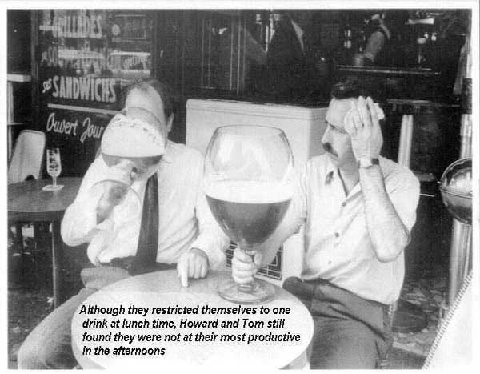

Slide 23
Coping with Stress
BREATHING
THOUGHT PROCESS (how you think about it)
BALANCE IN LIFE
Talk
Support
Exercise
Good eating habits
Hydrate
Vacation
Crying
Humor

Slide 24
BREATHING

Slide 25
THINKING

Slide 26
Taking in the Good
*Rick Hanson, PhD
Neuroplasticity
  Pull Weeds and Plant Flowers
  Turn positive facts into positive experiences
  Savor the experience
Change the Thought; Change the Brain
  Lifts Mood
  Increases Optimism
  Increases Resilience
  Increases Resourcefulness

Slide 27
BEWARE THE “ANT”
Daniel G Amen, MD
ALL OR NOTHING THINKING
  Focusing on the negative
  Fortune telling with worst possible outcome
  Mind reading
  Thinking with your (negative) feelings
  Guilt beating (should, must, etc.)
  Labeling self or someone else negatively
  Personalizing
  Blaming others for your problems

Slide 28
BALANCING

Slide 29
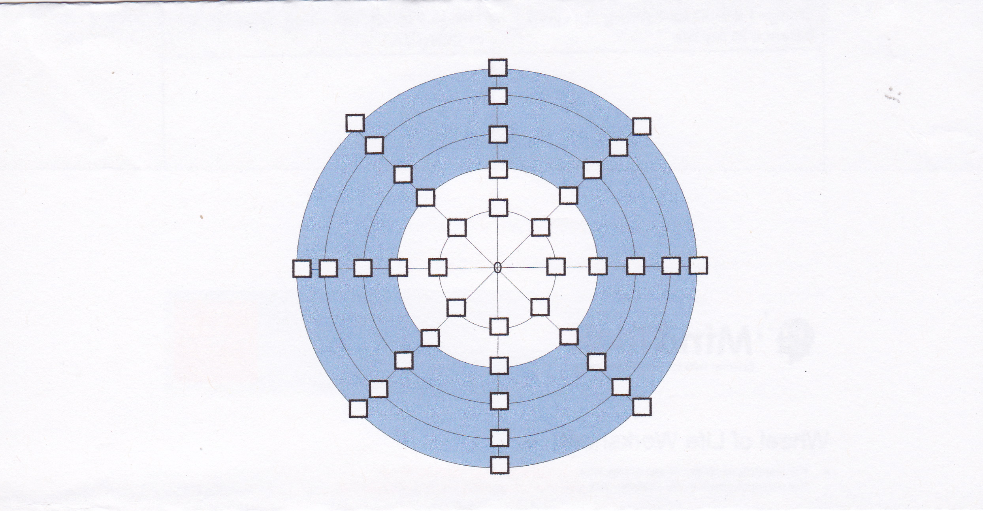
Wheel of Life

Slide 30
MINDSIGHT

Slide 31
Mark Twain
Without understanding, our worries and thoughts create huge unnecessary problems.
- My life has been filled with terrible misfortunes … most of which never happened.

Slide 32
Reference Sources
Buddha’s Brain by Rick Hanson, PhD
International Critical Incident Stress Management Foundation
Mindsight by Daniel Siegel,MD

